Slide 1
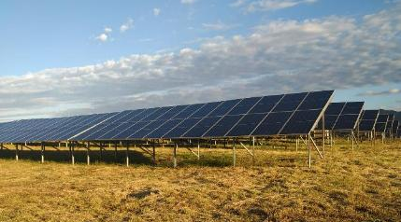
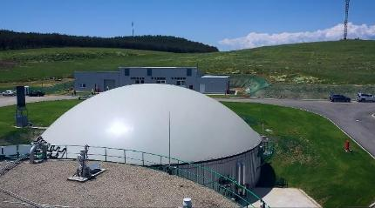
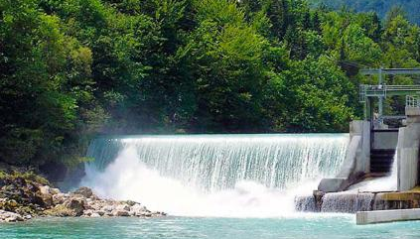

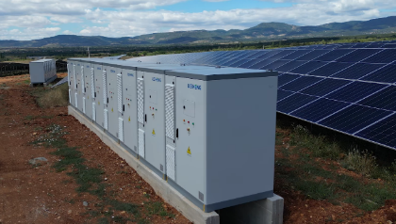


FEROINVEST
Leaders in RENEWABLE ENERGY for 22 years
Optimal solution for BATTERY ENERGY STORAGE SYSTEMS
OHRID
05.10.2025

Slide 2
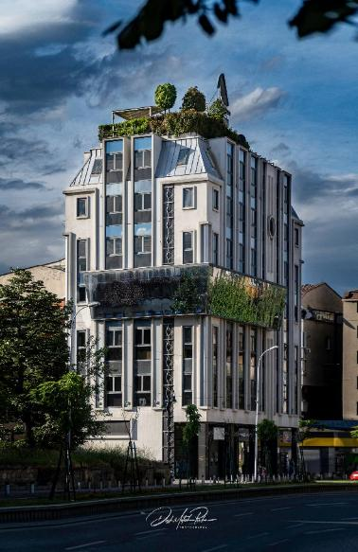
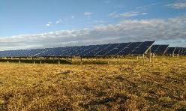

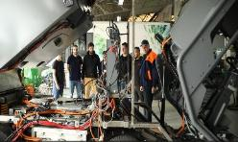
Dreamscape 1
ОUR MISSION
We build power plants from renewable sources, from which we deliver
green electricity to our clients, keep the world's capitals clean
with environmentally friendly vehicles of advanced
technologies and produce premium metal products
in multiple branches.
ABOUT US
Exporting to 60 countries;
First investor of RES in the region;
First manufacturer of hydrogen powered sweeper in
the world;
The only ones with a "turnkey" offer for the construction of
power plants and the purchase of electricity.
For the past 22 years, FERO INVEST has been a leader in its fields. Now,
FERO INVEST is shaping the future that will rest on new principles.
The headquarters of FEROINVEST in the Skopje city centre

Slide 3

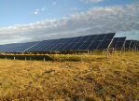
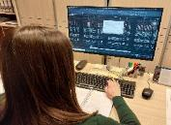
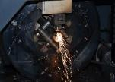
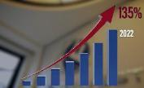


Welcome to the corporation that brought the era of renewable sources to Macedonia and the region.
Feroinvest is a leader in the construction of RES and in the introduction of electric and hydrogen propulsion in vehicles.
Widespread use of new clean energy sources is our mission in the decade ahead.
FERO INVEST THROUGH
FIGURES, IMAGES & FACTS
RES and metal
1000
2003
FERO INVEST is a company with business activities in the sector of renewable energy sources and in the metal processing industry
FERO INVEST is a LLC with about 1000 employees and is one of the most successful Macedonian business entities.
FERO INVEST was established in 2003 and together with the sister company Central Invest they run the business by managing 30 companies in North Macedonia and around the world.
135% growth in 2022
28.000.000 €
100+ engeneers
In 2022, FERO INVEST invested 28 million euros in several environmental projects
The Feroinvest group employs more than 100 engineers from all areas
new power plants
development of new sweepers
new production lines
In 2022, the FERO INVEST/Central Invest group achieved 113 million euros in revenue, which represents a growth of 135% compared to 2021

Slide 4
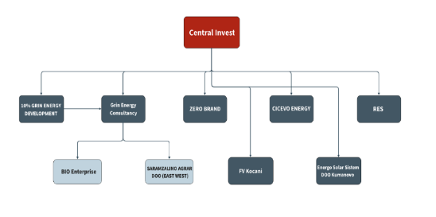
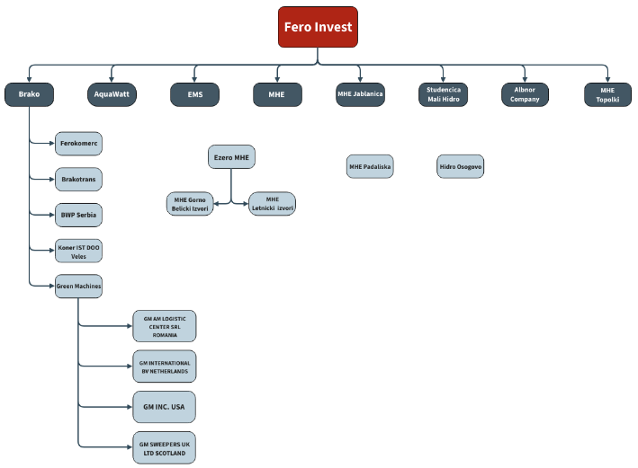
ORGANIZATIONAL STRUCTURE

Slide 5

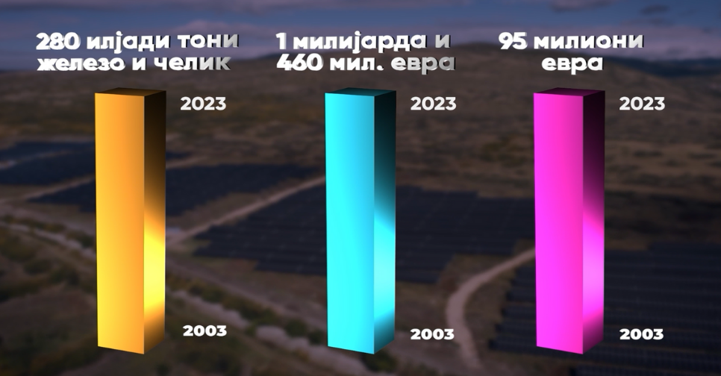
20 YEARS OF FERO INVEST & BRAKO
-OUR ACHIEVEMENTS-
METAL PROCESSING
TOTAL REVENUE
TOTAL INVESTMENTS
280.000 t
of steel and iron
1.400.000.000
€
95.000.000
€

Slide 6
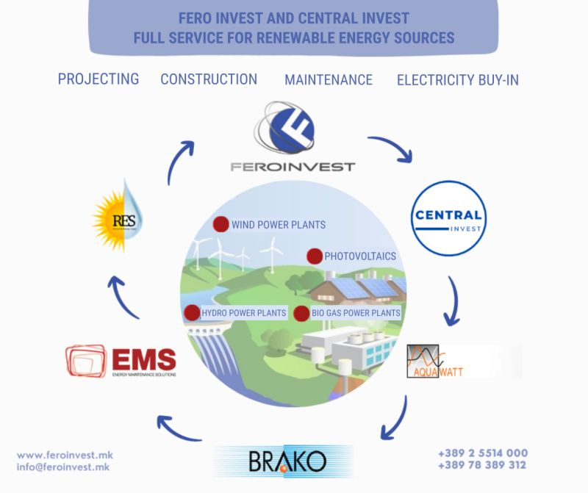
FERO INVEST
TURNKEY SOLUTIONS
FOR
RENEWABLE

Slide 7

CONSTRUCTION OF SMALL HYDRO POWER PLANTS
ON A TURNKEY PRINCIPLE
OUR SERVICES
Specification and
pre-design
Consulting services
Design and Construction
Heavy machinery and transport support
Electro-Mechanical Equipment Installation, Testing & Commissioning
Inspection & Examination
SCADA system & Monitoring
Maintenance
Automation systems
Research & Development
7 battery energy storage systems

Slide 8
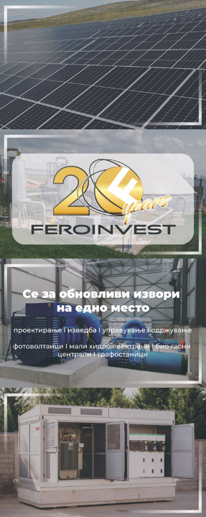
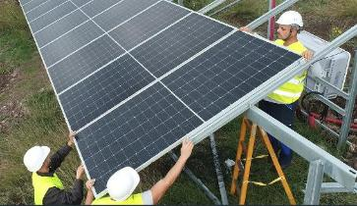
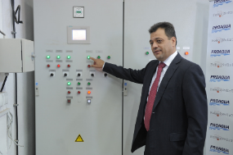
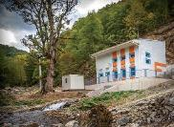
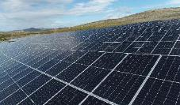
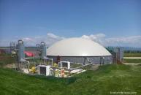
FEROINVEST is the first company in Macedonia and in the region that started implementing the energy transition 15 years ago, by building power plants from renewable sources.
We are still building our own power plants, which will increase our electricity production in the future.
ENERGY
Construction of power plants from renewable sources
Own electricity production
FEROINVEST is a leader in the field of renewable sources for electricity production.
Until now, Feroinvest has built and maintains power plants with a total installed capacity of 130 MW, some of which are owned by us, while some were built for our customers in the country and abroad.
Feroinvest team in the construction of PVPP Trkanje,
Kochani, July 2022
The owner of FEROINVEST Мr. Kocho Angjushev PhD
at the releaseat SHPP "Belica 1" in 2010
25
Small hydro
power plants
5
Photovoltaic
power plants
1
Biogas
power plant
FERO INVEST annually produces on average 125.000 MWh of electricity from own power plants from renewable source
Power plants owned by Feroinvest

Slide 9
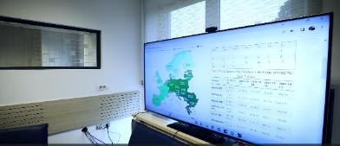
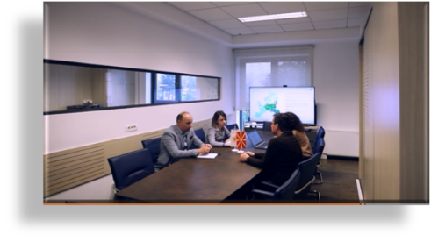
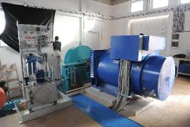
CONSTRUCTION AND MAINTENANCE OF RENEWABLE SOURCES POWER PLANTS
TURNKEY SOLUTIONS
Feroinvest is a vertically integrated energy company with all the necessary segments, which offers turnkey solutions for the design, construction and maintenance of power plants from renewable sources.
Feroinvest offers the construction of:
  Small hydroelectric plants
  Photovoltaic power plants
  Biogas power plants
Monitoring of the electricity markets in Europe
Own production of electricity gives us the opportunity to offer customers the most favorable conditions and create special offers for each customer.
Electricity purchase
We ensure the purchase of the produced electricity from the power plants from renewable sources, as well as the supply of electricity on the free market, primarily large companies, but also more and more companies from the group of small consumers.
FERO INVEST was the first company in the region which started to build small hydro power plants in 2010*.
Feroinvest's first hydro power plant was built on the territory of the municipality of Struga, as a PPP with the local public water company PROAKVA.
The best offer for the purchase and supply of electricity

Slide 10
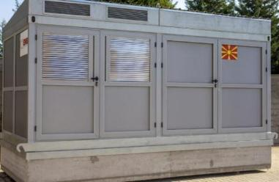
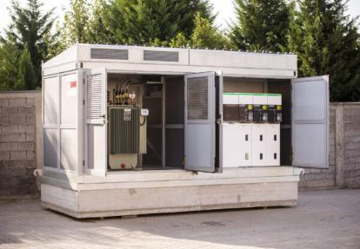
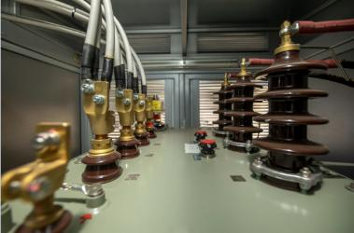
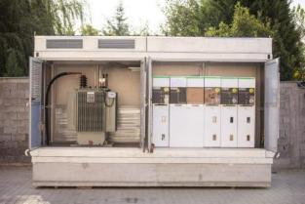
ELECTRIC SUBSTATIONS
Our company produces electric substations, which can be used for power plants of renewable sources of electricity, but also for other industrial facilities, for residential buildings and settlements, and for other needs of companies and citizens.
The substation was designed by the architects from FERO INVEST/EMS, the electrical equipment in the substation was made and connected by the engineers and technicians at EMS, and the metal assembly container was made by BRAKO.
The substation houses a transformer with a capacity for transformation from 10 KV to 800 V, as well as low-voltage and high-voltage cells.
The object is easily placed in the required location, with a concrete pedestal, which provides stability, and it takes only two months from order to delivery.
With this substation, FERO INVEST completes the process for the construction of power plants from renewable sources .

Slide 11
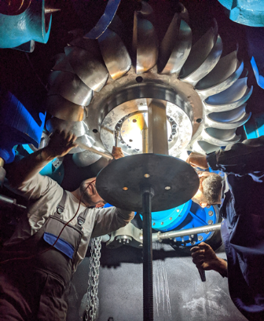




Electro-Mechanical Equipment Installation, Testing & Commissioning
Project design installation requires a team of uniquely qualified engineers which have the specialized knowledge and expertize to handle the most challenging installations
Commissioning services safeguard the immediate and long-term reliability, safety and performance of all critical systems and components.
Our full range of testing services includes: equipment testing, testing and installation reports etc.

Slide 12
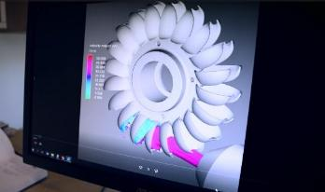
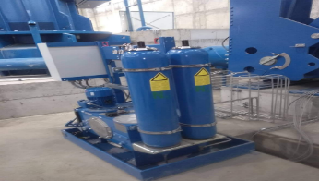
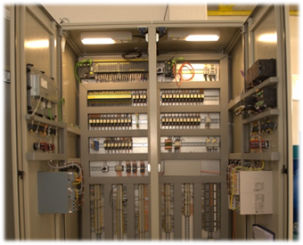
DESIGN AND CONSTRUCTION
Design and construction of turbines
and auxiliary equipment
Incorporating your specific requirements into construction and testing documents in accordance with pre-design specifications
Solutions for hydraulic turbine regulation
Solutions and design of LV, MV and HV
switchgears

Slide 13
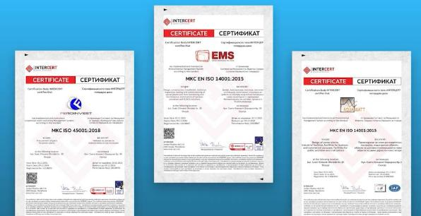
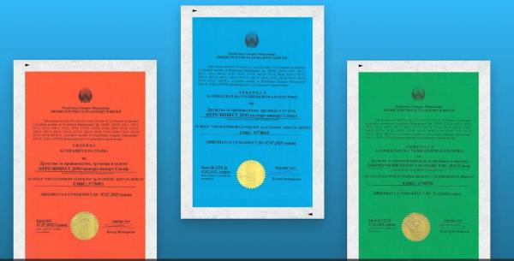
INSPECTION/EXAMINATION
EMS holds an ISO 17020 certificate of technical inspection and periodic testing of power plants, transformer substations, low voltage installations, relay protection and other electrical equipment
Commercial/Industrial – Electrical testing, inspection and reporting
Periodical verification of electrical installations (first & recurring)
Thermo-graphic measurement of electrical installations

Slide 14

Turnkey Contracts
Legal Department – FEROINVEST
Preparation of documentation for obtaining a Building Permit or a Decision for installation of structures/equipment in accordance with the Construction Law
Assistance in the procedure for obtaining a Decision on grid connection approval before Elektrodistribucija DOOEL Skopje
Preparation of documentation for procedures before the Ministry of Energy in line with the new Energy Law
Assistance in the procedure for obtaining Licenses for electricity production before the Energy Regulatory Commission

Slide 15
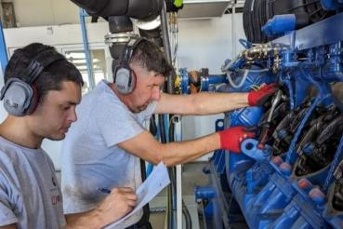
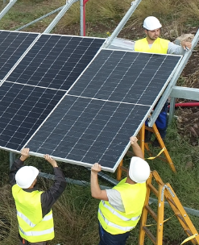
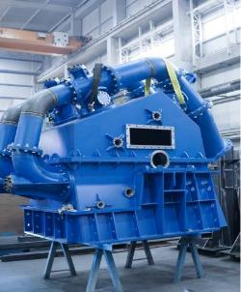
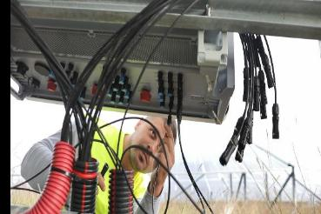
MAINTENANCE
From simple repairs to general
overhauls to the original state of
the electro-mechanical equipment
Preventive and regular maintenance
Delivery and fitting of spare parts
Emergency support, consultation and assistance when needed

Slide 16
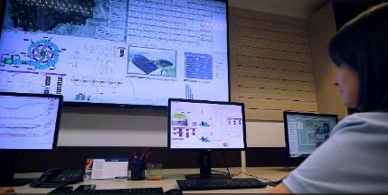
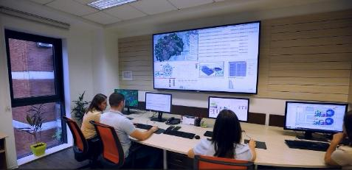

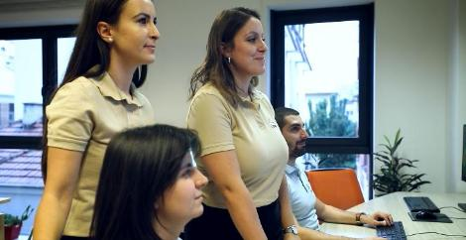
MONITORING
24-hour monitoring system of the power plant, in order of continuously production of the power plant.
The operation of all power plants is monitored from one center, with all parameters for each facility separately.
.
Professional monitoring of the operation of the power plant from minute to minute
Instant response
Detecting the problem
Solving the problem on the spot
Returning the power plant to regular operation mode
The center is equipped with a SCADA system of the last generation and operated by top professionals 24/7, with an alarm system for dispatchers on duty.
24-hour monitoring of the operation of power plants
Our team is 24/7available for support with remote diagnostics of the failure
Data analysis and diagnostics
Remote tuning of operational parameters
Various types of reports according to customer needs
Our team of engineers in the monitoring center

Slide 17


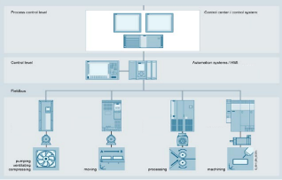
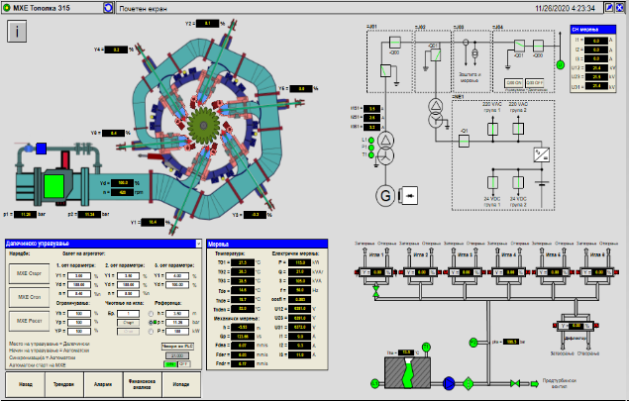
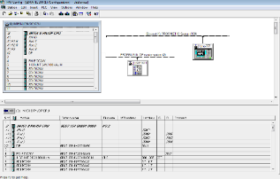
AUTOMATION SYSTEMS
EMS provides complex automation and SCADA solutions for
all types of processes, from engineering to start-up
We plan, build, install and commission
complete automation systems
We optimize overall system to achieve highest
availability and efficiency at best cost

Slide 18


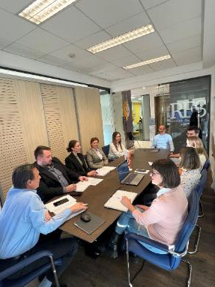
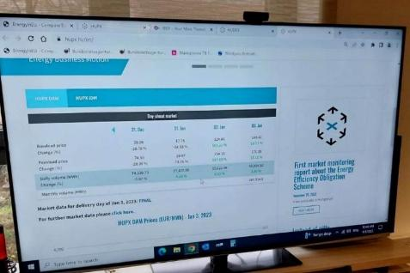
RES (Renewable Energy Supply)
Guaranteed purchase of the produced electricity through the leading electricity trading company, RES, with a balance group of more than 600 customers.
The purchase of electricity from the renewable sources power plants, primarily photovoltaic power plants, is becoming the biggest challenge for manufacturers, for which we have a solution with our offer for guaranteed purchase.
We implement the principles of circular economy.
Our solutions reduce the consumption of natural resources and minimise waste, and are designed to recycling of materials.
#greenenergy
We are aiming for zero carbon CO2 mission
RES is a company that offers an innovative approach to the supply of electricity, and that integrates producers of electricity from renewable sources in one center, through which it provides reliable, stable, but also cheaper supply for Macedonian companies.

Slide 19
Consulting services
EMS provides a wide area of advisory services that address the strategic, technical, regulatory and financial needs of our clients involved in the energy and utility sector
We offer consulting services for investors before, during and after investments in renewable energy. These consulting services can be legal consulting or technical feasibility services where we offer our experience in renewables transformed into a valuable asset of the investor
We help investors negotiate a better connection point with the network distributor, by calculating with specialized software the optimal connection to save investment & time
SE NPC Ukrenergo, Ukraine - Implementation of second power transmission project
Reconstruction of 330kV substations
Installation of 20 MVAr reactive power compensation devices on 35 kV busbar for five substations
Implementation of Smart Grid
Implementation of management information system
Implementation Balancing Market
MEPSO Rehabilitation and Control Project Supply and Installation of Relay Protection
HPP Tikves
HPP Spilje
HPP Vrutok
HPP Globocica
MEPSO Rehabilitation and Control Project Supply and Installation of Relay Protection
S/S Skopje 1
S/S Skopje 4
Georgian State Electro system JSC, Implementation of Open Programme Extension of the Transmission Network II
Substations: 500/220/110kV Nenskra, Extension of 220/110kV Jvari to 500kV and 220kV switchgear at SS Tskaltubo
Overhead lines: 500kV OHTL S/C SS Jvari-SS Nenskra, 220kV OHTL D/C SS Nenskra-SS Mestia, 500kV OHTL S/C SS Lajanuri-SS Tskaltubo, etc

Slide 20



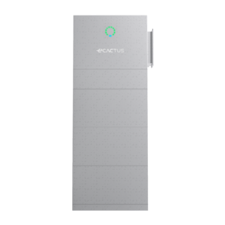
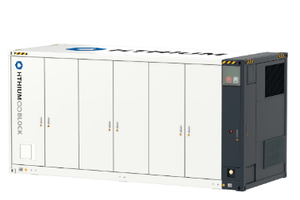
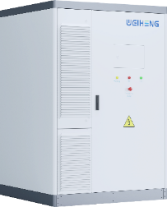
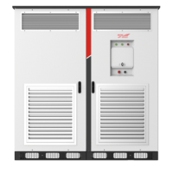
BATTERY ENERGY STORAGE SYSTEMS
FERO INVEST offers turn-key solution for lithium battery energy storage systems. We have solutions for households, commercial buildings, industry, and large-scale (utility) batteries.
We cooperate with Tier 1 producers of batteries, such as WHES (Weiheng), Hithium and Kehua, ensuring the highest level of quality and performance.
6-10kW/10-30kWh
100kW/233kWh
1,25-2,5MW/4-5MWh

Slide 21




BATTERY ENERGY STORAGE SYSTEMS
The most important parameter of any BESS is the quality of the battery module and the EMS. The quality of the battery module ensures safety and longevity of the system, while the EMS ensures stable operation. Without a fully developed EMS, confirmed to be fully compatible with both the battery module, BMS, and PCS manufacturer, the BESS will never work.
We use WHES (Weiheng-Tech) Tianwu solution up to 11MWh, which comes integrated with a state-of-the-art EMS “PANGU OS”, fully compatible with the CATL battery modules installed inside. It supports web cloud viewing, mobile application.
For larger projects, we use Hithium + Kehua Container Battery Energy Storage System. We use SolarPro’s SCADA/EMS solution which has been used for many years in more than 1GWh installed BESS worldwide, using exactly the same Hithium + Kehua configuration. SolarPro are our long-term partners, and one of the biggest European Integrators for BESS.

Slide 22

One of our seven battery energy storage systems:
2,7MW PV + 1,6MW/3,7MWh

Slide 23

PREVIEW OF PANGU OS EMS

Slide 24


Slide 25


Slide 26





Slide 27

One of the container BESS that have worked on together with SolarPro:
25weMW/55MWh

Slide 28
CONDUCTS A FEASIBILITY STUDY
FERO INVEST DEVELOPED A PROGRAM THAT AUTOMATICALLY:
ANALYZES THE ELECTRICITY BILLS FOR YOUR FACILITY
CONDUCTS A FEASIBILITY STUDY
RECOMMENDS THE OPTIMAL SOLUTION FOR YOU
1
2
3
4
5
6
7
8
Savings per
cycle
Number of cabinets
[EUR/MWh]
Storage
Capacity
233
466
699
932
1.165
1.398
1.631
1.864
Weiheng (WHES)
[kWh]
Battery period
from
183
233kWh/100kW
Payback
period
3,3
3,3
4,5
5,7
6,9
8,1
9,3
10,5
[years]
ALL YOU NEED TO DO IS SEND US YOUR HOURLY CONSUMPTION AND PRODUCTION PROFILES, and WE’LL TAKE CARE OF THE REST.

Slide 29

On July 14th, 2024, the lowest hourly spot price was -72.85 EUR/MWh, while the highest hourly spot price reached 416.27 EUR/MWh.
On July 14th, 2024, the lowest hourly spot price was -72.85 EUR/MWh, while the highest hourly spot price reached 416.27 EUR/MWh.

Slide 30

On July 18th, 2024, the lowest hourly spot price was 78.83 EUR/MWh, while the highest hourly spot price reached 999.01 EUR/MWh.

Slide 31
Market price in August 2025 for electricity produced from PV: 35 EUR/MWh
If a 1MW photovoltaic plant has a 2MWh battery installed, the electricity in August could be sold at an average price of.
65 EUR/MWh
1MW PV – 2MWh battery – 65 EUR/MWh

Slide 32
Market price in September 2025 for electricity produced from PV: 59 EUR/MWh
If a 1MW photovoltaic plant has a 2MWh battery installed, the electricity in September could be sold at an average price of 100 EUR/MWh.
1MW PV – 2MWh battery – 100 EUR/MWh

Slide 33



FERO INVEST
THANK YOU FOR YOUR ATTENTION
OHRID
05.10.2025

